Slide 1




PPT模板下载：www.1ppt.com/moban/ 行业PPT模板：www.1ppt.com/hangye/
节日PPT模板：www.1ppt.com/jieri/ PPT素材下载：www.1ppt.com/sucai/
PPT背景图片：www.1ppt.com/beijing/ PPT图表下载：www.1ppt.com/tubiao/
优秀PPT下载：www.1ppt.com/xiazai/ PPT教程： www.1ppt.com/powerpoint/
Word教程： www.1ppt.com/word/ Excel教程：www.1ppt.com/excel/
资料下载：www.1ppt.com/ziliao/ PPT课件下载：www.1ppt.com/kejian/
范文下载：www.1ppt.com/fanwen/ 试卷下载：www.1ppt.com/shiti/
教案下载：www.1ppt.com/jiaoan/
Analysis of Urban Flood-waterlogging
and
Design of Road Drainage System Based on
Low-Impact-Development(LID)
Minghao Chen
Email: minghaochen@my.swjtu.edu.cn
Department of Civil Engineering, Southwest Jiaotong University

Slide 2


Contents
Backgrounds
The potential flooding area evaluation model (PFAEM)
Design of LID system
Conclusions

Slide 3

Backgrounds

Slide 4
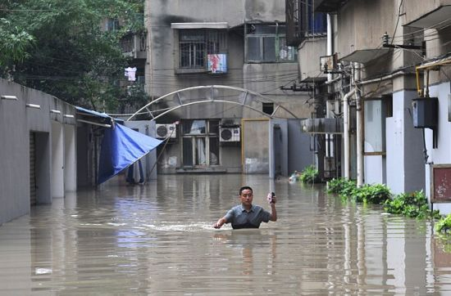
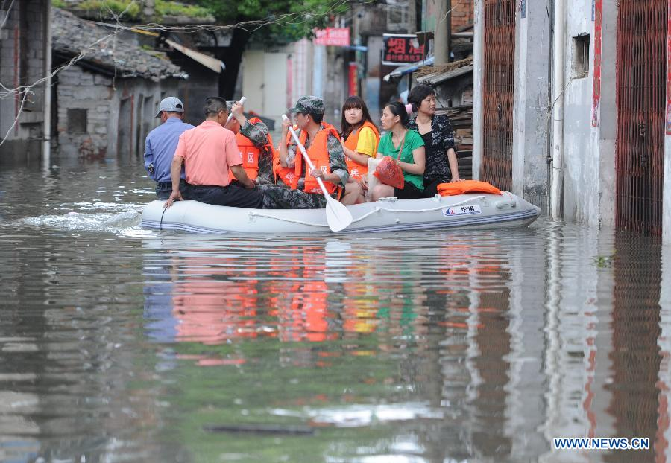
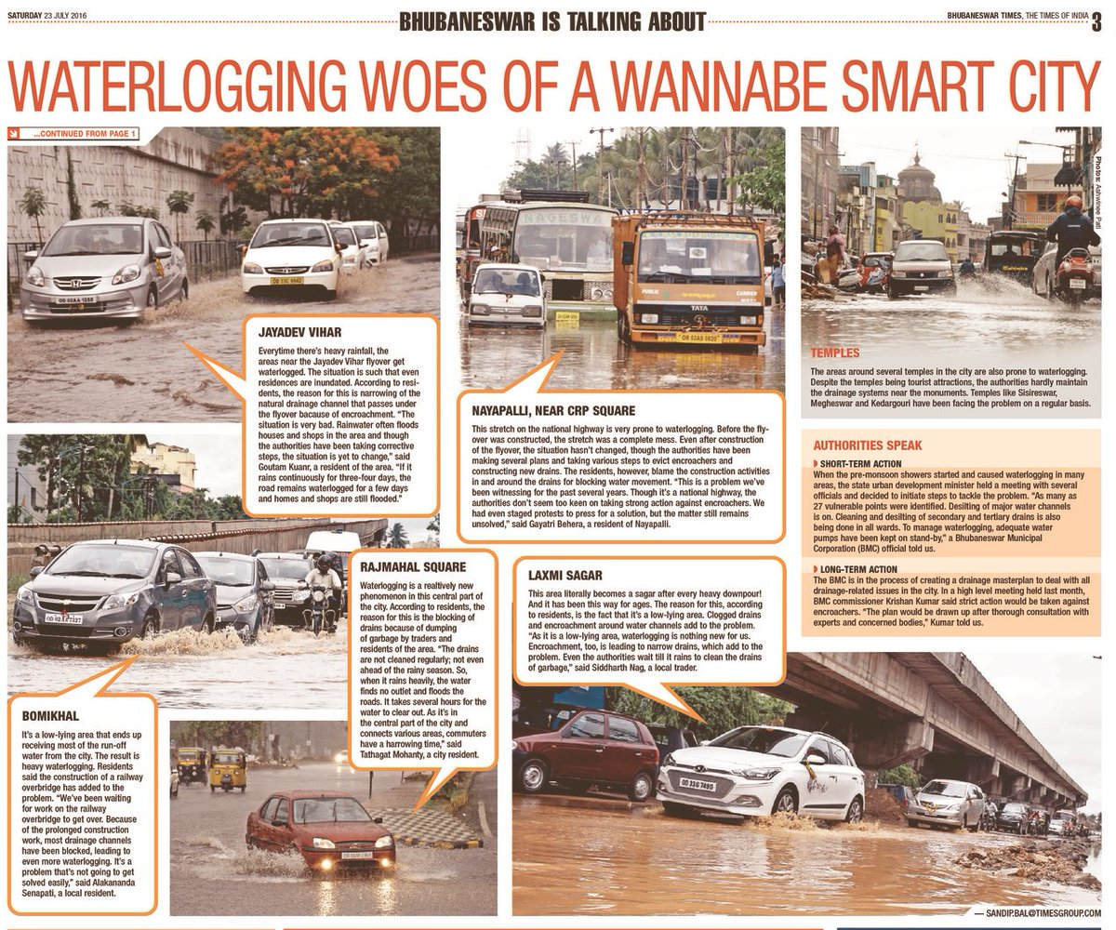
Backgrounds
The issue of urban flood-waterlogging has become increasingly prominent!!!
Chengdu, China
Wuhan, China
Odisha, India
10.7 million people were affected, 2 died and 1 was missing.
The direct economic loss of disaster is about 4.8 billion yuan.
At least 600 people have died and thousands are stranded or missing on the edge of the Himalayas.
【DIRECTORY】

Slide 5
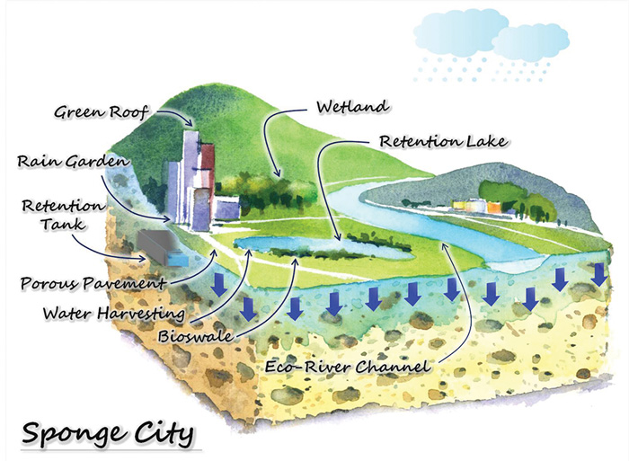
Backgrounds
Reasons
“Sponge City”
&
LID
Weakness
Hard to
construct in
the entire city
Rapid
development of
the city
Hard to
construct in
the entire city
No
comprehensive analytical methods
Lagging
drainage system
design
No
comprehensive analytical methods
No
BIM tech
introduced
Conservative design concept:
“Drainage-based”
【DIRECTORY】

Slide 6
Potential Flooding Area Evaluation Model

Slide 7



Establishment of PFAEM
Mathematic model:
Indexes:
Green Area
Precipitation
The current green area in various districts in Chengdu.
Monthly precipitation in various districts of Chengdu in the past three years.
Historical Floods
The number and magnitude of water-flogging in various districts of Chengdu in the last three years.
Water Pollution
Water pollution in Chengdu in the past three years.
【DIRECTORY】

Slide 8
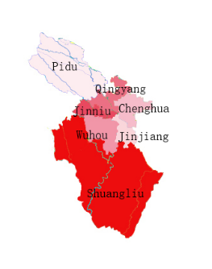
Results
According to the results of the correlation degree matrix obtained, the ranking of potential flood disaster hazards in various districts of Chengdu can be obtained as shown. The greater the degree of association, the higher the risk ranking of flood disasters.
The “Shuangliu” is the most likely district for potential flood disasters in Chengdu.
Ⅰ
Ⅱ
Ⅲ
Ⅳ
Ⅴ
Ⅵ
Ⅶ
【DIRECTORY】

Slide 9
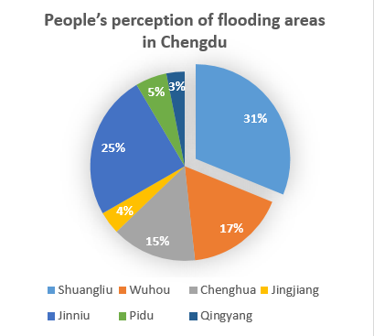
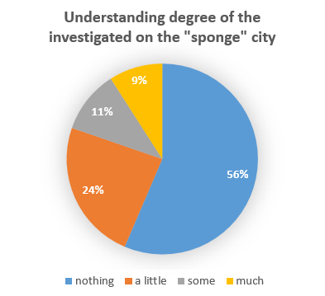
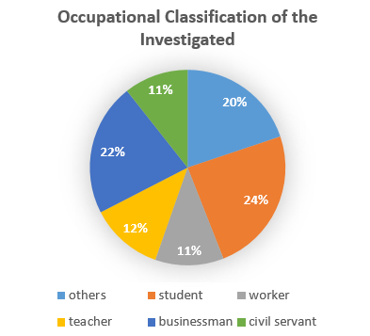
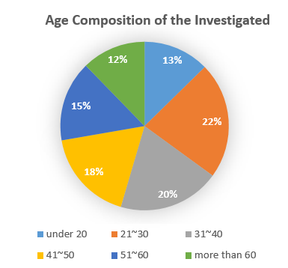
Verification
We made a questionnaire survey in Chengdu to provide reference and revised models for the results of the model. In our investigation, there are 31% people think “Shuangliu” is the most likely district, and the PFAEM model results are similar to this.
【DIRECTORY】

Slide 10
Design of LID system

Slide 11
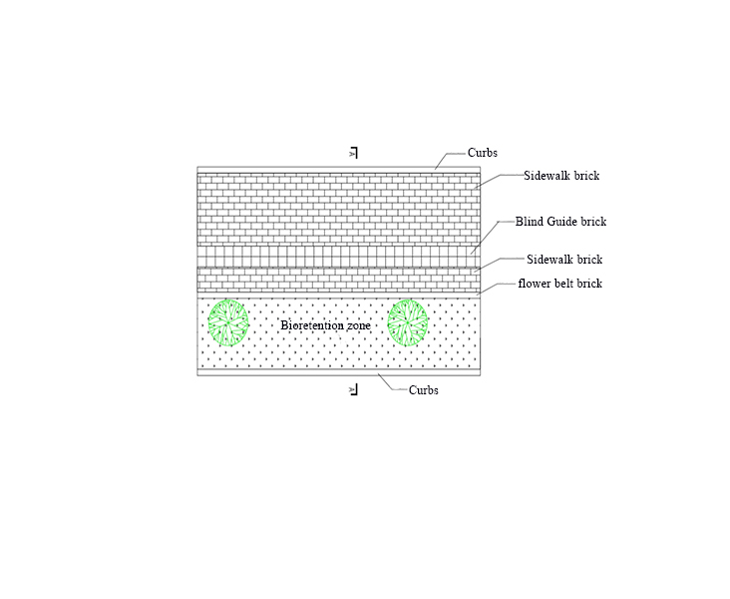
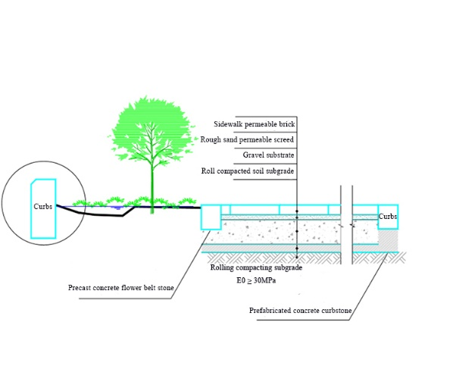
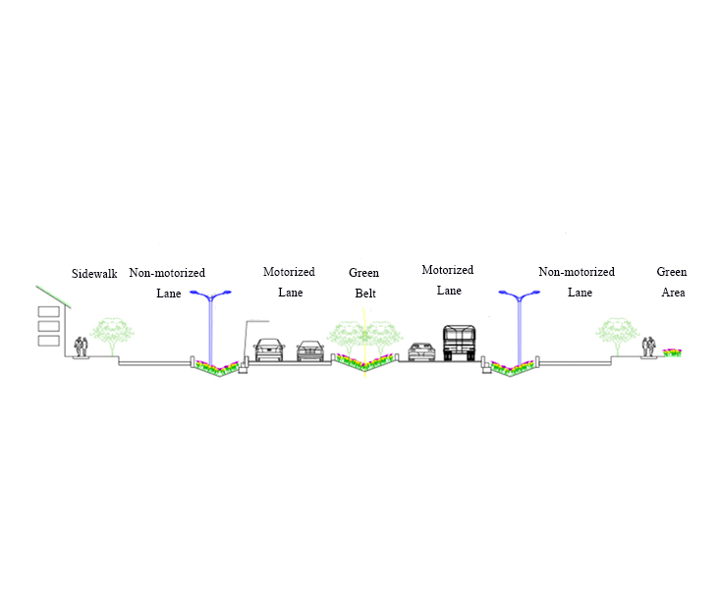
AutoCAD design in road
PAVEMENT
A - A SECTION
“Sponge” city four road cross-section arrangement type
【DIRECTORY】

Slide 12
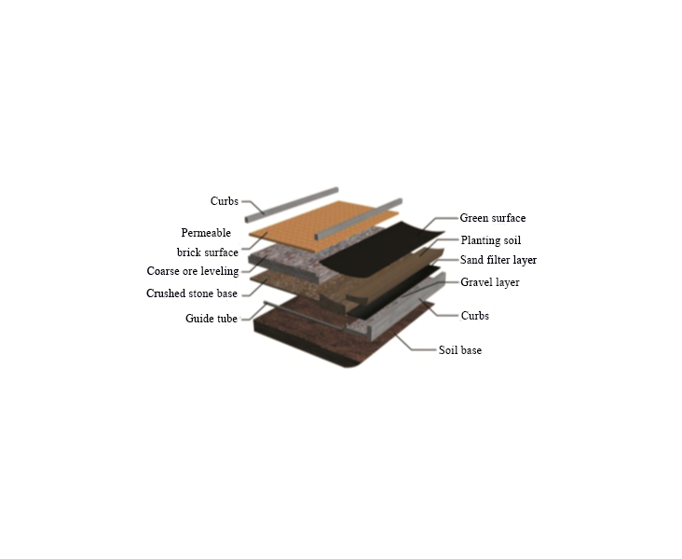
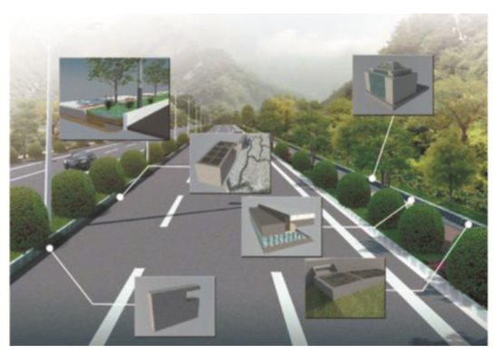
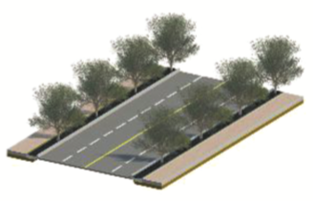
Building information model design in road
With Revit, sweeping can create a 3D model of the road as shown. Using BIM technology to design, we can intuitively see the internal structure of the road, which is conducive to our design changes and construction.
BIM Road model for “sponge” city
BIM Road internal structure for “sponge” city
【DIRECTORY】

Slide 13
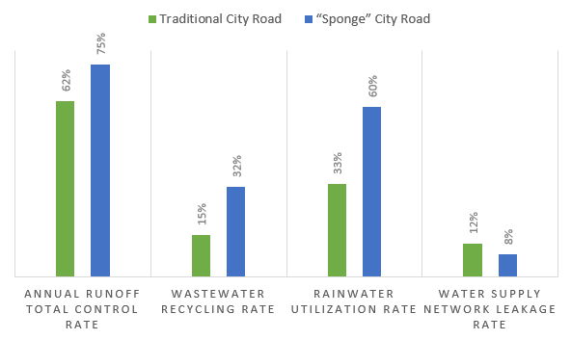
Discussion
“Sponge” city road vs. traditional city road
Use of “sponge” city roads designed in this paper can greatly reduce the risk of urban flood-waterlogging, while improving the utilization rate of rainwater resources and sewage regeneration and utilization.
【DIRECTORY】

Slide 14
Conclusions

Slide 15
Conclusions
By using numerical simulations, we can see that using our LID-based road model can achieve a total annual rate of 75% of annual runoff control, and all 3 positive rates are higher than before.
Shuangliu
75%
By using the PFAEM, we can find the “Shuangliu” should be the key construction district, which was consistent with the investigation results.
BIM design
By using BIM technology, we can better design and modify the model, and at the same time make the construction party more convenient. Compared with the traditional CAD design, the operability of the project is increased.
【DIRECTORY】

Slide 16
Credits

Slide 17
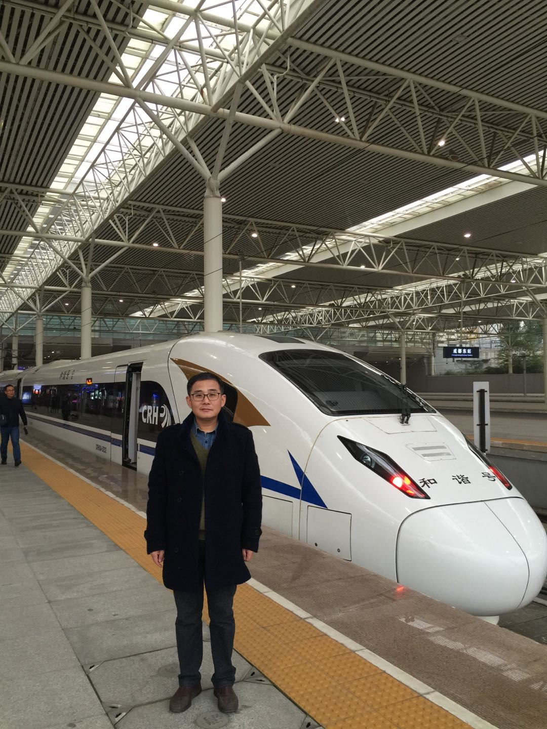

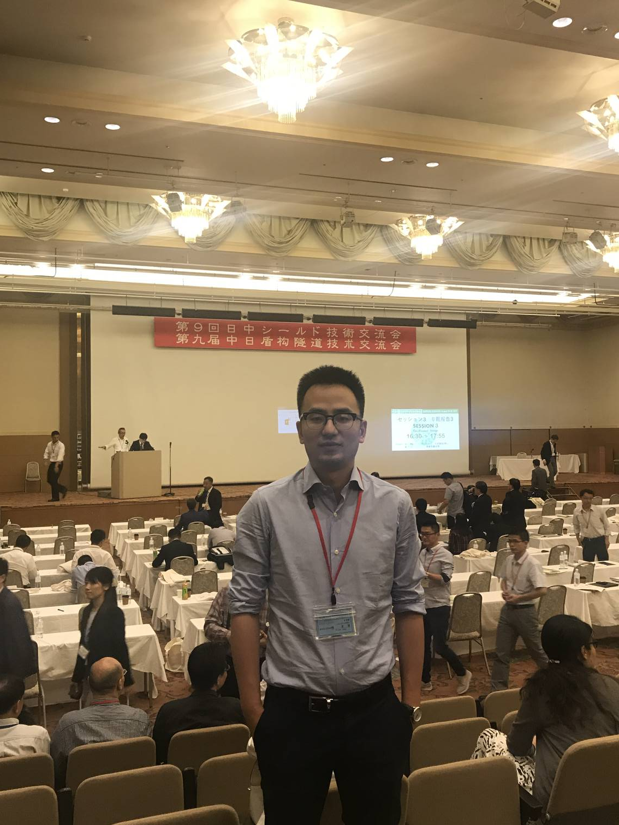
Credits
Prof. Tao Huang,
Department of Earth Science and
Environmental Engineering
Southwest Jiaotong University
Department of Civil Engineering
Dr. Wenbo Yang,
Department of Civil Engineering
Suggestions in research goal and paper.
Support for research.
Suggestions in paper and oral presentation.
【DIRECTORY】

Slide 18

THANKS
FOR WATCHING

